Slide 1
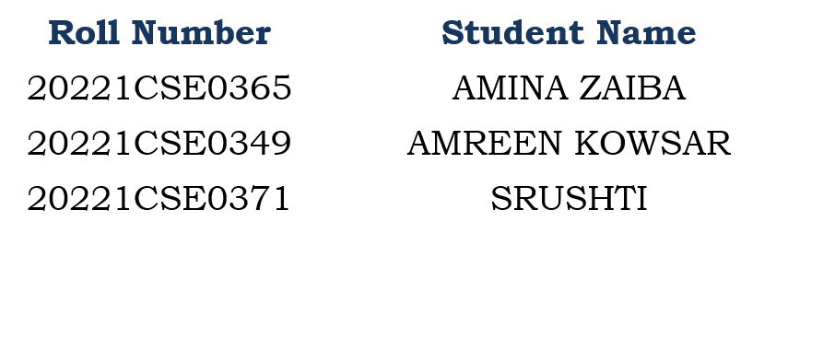
Student Innovation :”A Creative Web-Based Learning application Integrating Notes,Quizzes and Games”
CSE7101- Capstone Project
Review-2
Batch Number: CSE_107
Under the Supervision of,
Ms. Kalpana K Harish
Assistant Professor,
School of Computer Science and Engineering
Presidency University
Name of the Program: CSE
Name of the HoD: Dr. Asif Mohammed
Name of the Program Project Coordinator: Dr. Jayavadivel Ravi
Name of the School Project Coordinators: Dr. Sampath A K , Dr. Geetha A

Slide 2
Problem Statement Number: PSCS_240
Organization: AICTE, MIC-Student Innovation
Category : Software
Problem Description: Smart Education, a Concept that Describes learning in digital age.it enables learner to learn more effectively, efficiently, flexibly and comfortably.

Slide 3
Content
Abstract
Objectives
Literature survey
Proposed method and feasibility
Architecture Diagram
Block Diagram
Flow Chart
SDGs
Software Details
Git-hub Link
Timeline of the Project
References

Slide 4
Abstract
Interactive education portal for students
Combines aptitude quizzes and memory games in a single platform
Improve logical reasoning and memory power in an engaging way
Lightweight, simple, browser-based

Slide 5
Objectives
Create a fun and engaging web app for children’s learning.
Use only HTML, CSS, and JavaScript.
Make it ad-free, easy to use, and work on any device.
Combine aptitude quizzes and memory games in one platform.

Slide 6
Literature Survey
Literature Table: HERE

Slide 7
Proposed Method & Feasibility
Develop a Teacher–Student Web Application with two login roles.
Teacher: Upload notes, create quizzes.
Student: Access notes, attempt quizzes.
Quiz Engine: Evaluate scores automatically.
Game Unlock Logic: Students scoring 6/10 unlock mini learning games (memory, word game, puzzle).
Use HTML, CSS, JavaScript for development.

Slide 8
Proposed Method & Feasibility
Technical Feasibility – Open-source technologies make implementation possible.
Economic Feasibility – Low-cost development, no expensive licenses.
Operational Feasibility – Simple UI ensures easy adoption by teachers and students.
Time Feasibility – Can be implemented in phased development (login → notes → quiz → games

Slide 9
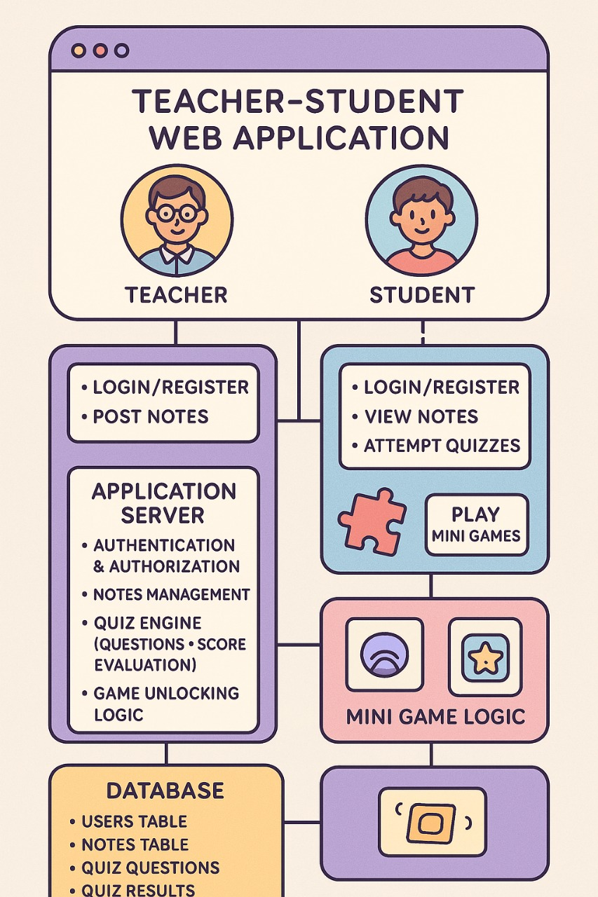
Architecture Diagram

Slide 10
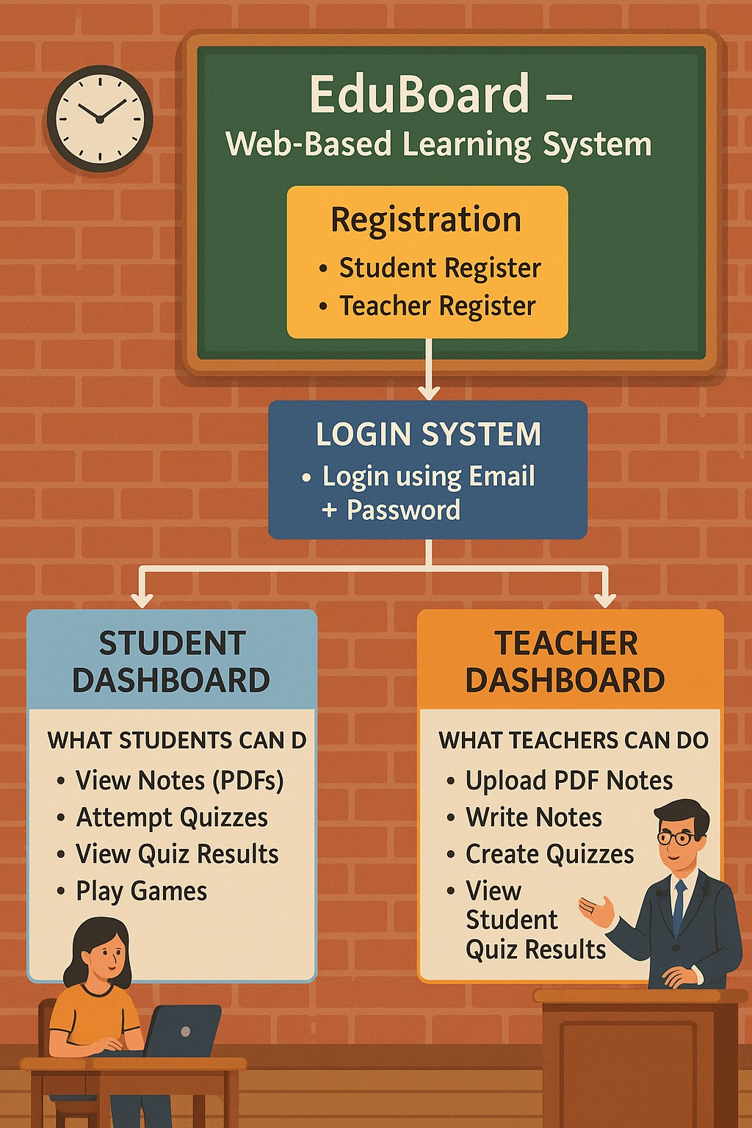
Block Diagram

Slide 11
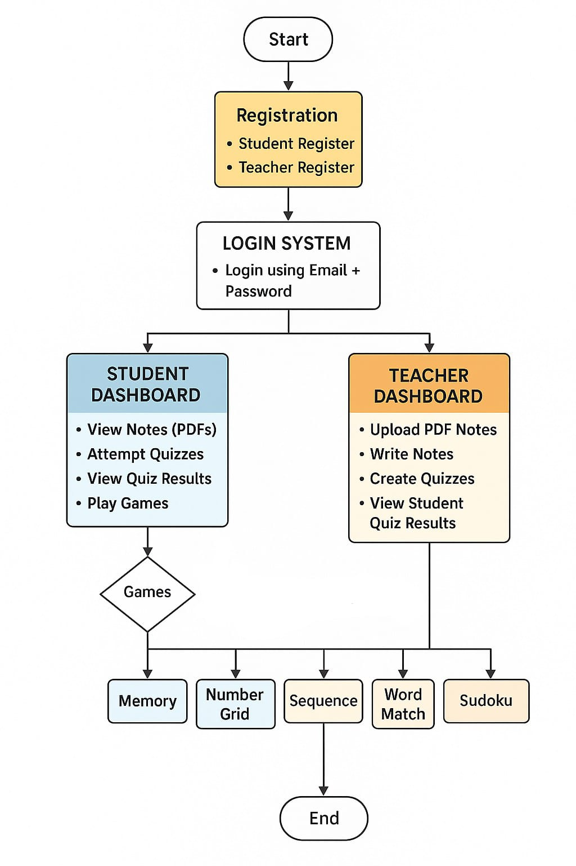
Flow Chart

Slide 12

SDGs

Slide 13
SDGs
SDG 4: Quality Education- The web-based learning app promotes inclusive, accessible, and interactive digital education for all learners.
SDG 9: Infrastructure, Industrialization and Innovation-The project uses innovative digital infrastructure to enhance teaching, learning, and academic resource delivery.
SDG 10 Reduced Inequalities-By providing equal access to notes, quizzes, and learning tools, the system reduces educational gaps among students.
SDG 17 Partnerships to achieve the Goal-The platform strengthens collaboration between teachers and students through shared learning resources and communication.

Slide 14
Software Details
HTML, CSS, JavaScript
Any modern web browser (Chrome, Firefox, Edge).
Runs locally or online without extra software.
Lightweight for quick loading
Modules
Simple design with easy navigation
Multiple-choice questions with instant scores
Card-flip and puzzle games
Shows results after each quiz/game (saved temporarily in browser)

Slide 15
Github Link
Github Link:
https://github.com/capstoneteam107/capstone107.git

Slide 16
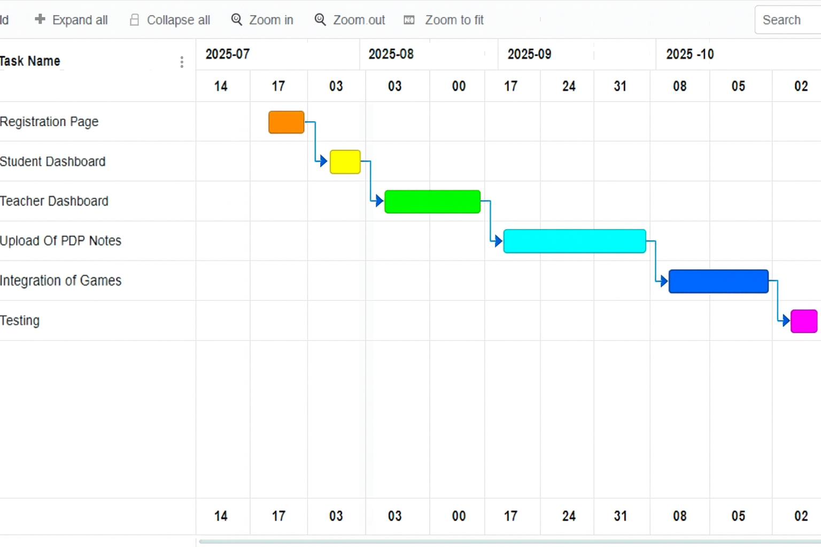
Timeline of the Project (Gantt Chart)

Slide 17
References (IEEE Paper format)
Cook, D. A. (2007). Web-based learning: pros, cons and controversies. Clinical Medicine, 7(1), 37-42
Vlachopoulos, D., & Makri, A. (2017). The effect of games and simulations on higher education: a systematic literature review. International Journal of Educational Technology in Higher Education, 14(1).
Kefalis, C., & Drigas, A. (2019). Web Based and Online Applications in STEM Education. International Journal of Engineering Pedagogy, 9(4), 123-135
Drigas, A., & Karyotaki, M. (2016). Online and other ICT-based Training Tools for Problem-solving Skills. International Journal of Interactive Mobile Technologies, 11(6).

Slide 18


